Slide 1
Getting Started With Contributing To Open Sources
Tapasweni Pathak

Slide 2
Your contributions can be ..
Code
Documentation Patches
Finding a bug
Raising an installation issue
Blogs about your experience
Answering a question

Slide 3
You can contribute by..
Making your own project open source.
Contributing to an already existing project.

Slide 4
Some Terminologies
Patch
Issue, bug

Slide 5
GitHub Based Terminologies
Repository
Pull Request
Fork
Issue
Star
Watch

Slide 6
Where to start?
Find the source code, clone, install, run.
Find the documentation.
Find the issue/bug tracker. Pick newbie friendly bugs.
Find the mentor, maintainers of the project.
Find the IRC channel, mailing list.

Slide 7
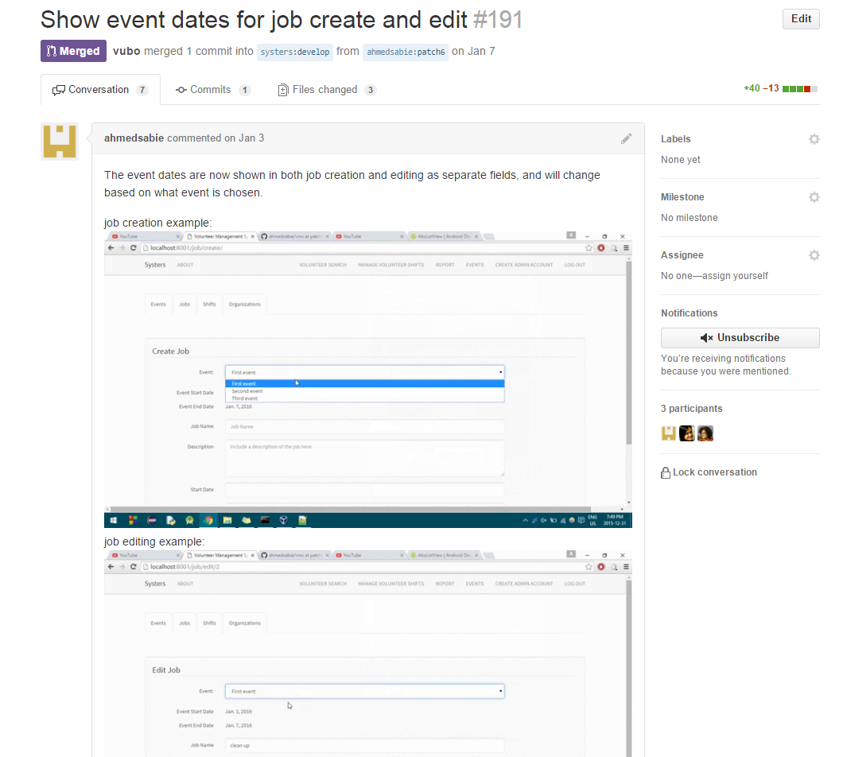
How does a good GitHub PR looks like?

Slide 8
Proper commit messages.
Proper commit message division.
Using closes, fixes in your PR to reference the issue.
Adding a GIF or image of the output your code edits bring.
Explain your changes.
Use proper Markdown.

Slide 9
Are all open source project on GitHub?
No.

Slide 10
Beginner Friendly Resources
Gnome-love bugs.
Linux Kernel newbies.
WhatcanIdoforMozilla?

Slide 11
Open Source Programs
Season of KDE
OWASP SOC
Mozilla Winter of Security
Outreachy
RGSOC
TOR Summer of Privacy
GSOC
SOCIS
More SOC-Programs

Slide 12
Do’s
Read documentation.
Ask.
Learn if you don’t know the technology that the project uses.
Lurk on IRC’s.
Read.

Slide 13
Don’ts
Don’t get scared, get started!

Slide 14
Questions?

